Slide 1

MS Capstone Project
Mid - Semester Presentation Highlight
A Comparative Customer Churn Prediction and Retention Strategy Analysis Across SaaS, Telecom, and Credit Card Subscription Businesses
Presented by:
Sadikshya Shrestha

Slide 2
Table of Contents
1
Problem Statement &
Project Objectives
6
Preliminary Visualization Work
2
7
Challenges Encountered and
Mitigation Strategy
Data Set Overview
3
7
Planned Analytical Approach
Modeling Methodology
Data Preparation Approach
4
Exploratory Data Analysis Insights
8
Updated Timeline
5
Modeling Methodolgy
7
Conclusion & Recommendations

Slide 3

Problem Statement
Project Objectives
Churn affects recurring revenue and increases the cost of acquisition.
For a subscription based model, it is important to proactively identify customers who are at risk of churning.
Need a comparative analysis to understand the differences in the customer churn behavior.
Create machine learning models to predict customer churn
Understand the behavioural and financial factors contributing to customer churn
Segment the customers according to the risk level

Slide 4
Data Set Overview
SaaS Data Set
Telecom Data Set
Credit Card Data Set
It includes data on subscription and usage metrics
It measures customer engagement based on login frequency or feature adoption.
It includes support interaction or issue resolution measures.
Churn refers to cancellations or downgrades of
subscriptions
It includes service plans, internet type, and add-on services.
It tracks customers' tenure and service cost variations.
It measures satisfaction levels based on billing methods and contract length.
Churn refers to service disconnection.
It includes credit limit, balance, and payment behavior data.
It measures customer spending habits and repayment behavior.
It indicates risk by observing trends in utilization or inactivity.
Churn refers to closure or non use of accounts

Slide 5

Data Preparation Approach
Credit Card Dataset
Remove identifier variables and transformed the churn variable into a binary variable
10,000
Handled missing values by imputing the median value and performing a logical operation
Customer
Record
Telecom
Dataset
7000
Multi table
Structured
Data
Integrated the SaaS multi-table data into the analytical dataset
Customer
Record
SaaS Datset

Slide 6



Exploratory Data Analysis Insights
Credit Card
Telecom
SaaS
Lower transactional activity and shorter relationship length contributed to churn
Higher credit utilization is a risk factor, contributing to churn
Customers with a month-to-month contract were likely to churn.
Higher monthly bills, shorter relationship, contributed to service termination.
Customers with lower feature usage intensity were more likely to churn.
More support interactions were a challenge, contributing to churn risk.

Slide 7





Modeling Methodology
Evaluation metrics used:
Implemented Logistic Regression as a interpretable baseline model
Utilized Decision Tree to understand churn decision rules
Utilized Random Forest to optimize predictive accuracy through ensemble learning
Accuracy
Precision
Preliminary Model Results:
Random Forest demonstrated the best predictive performance over all datasets.
Logistic Regression offered consistent predictions and variable understanding
Decision Tree offered moderate performance and improved understanding
Recall
F1 Score
ROC AUC

Slide 8
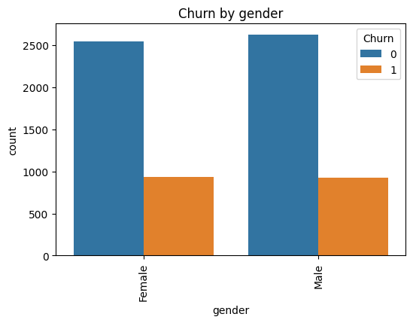
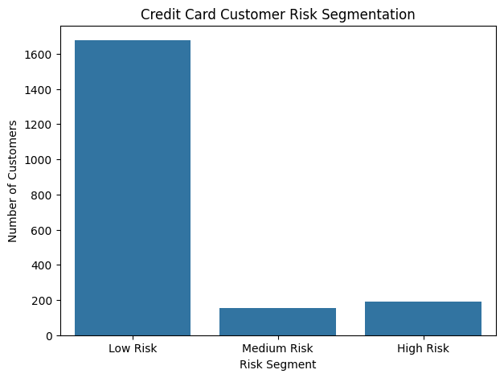
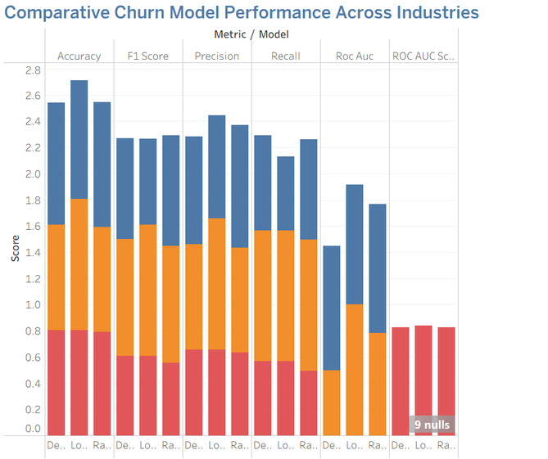
Preliminary Visualization Work
Thesis Title
Developed churn distribution and customer segments comparison charts.
Created model performance comparison charts.
Prepared churn risk segmentation outputs for Tableau visualization.
Churn by gender for telecom
Customer Churn Risk Segmentation
Comaparison Chart

Slide 9
Challenges Encountered and Mitigation Strategy
Data Integration in SaaS:
Multiple tables needed aggregation and merging
Solved by developing account level metrics for usage and support.
Missing data and quality:
Inconsistent billing and engagement variables
Addressed through data type correction and median/ zero imputation
Consistency in modeling across industries:
Different structures in datasets made comparison challenging
Standarlized preprocessing and same machine learning model used

Slide 10






Planned Analytical Approach
01
02
03
04
05
Carry out hyperparameter tuning and model optimization to improve the prediction result
Carry out customer risk segmentation to categorize into high, medium and low risk
Design interactive Tableau dashboards to present customer churn insights and model comparision result
Carry out cross-industry analytical comparison to compare industry churn causes
Develop strategic recommendations and report based on customer churn prediction
Insights

Slide 11
Updated Timeline
Week
9
Week
10
Week
11
Week
12
Week
13
Mid-semester evaluation presentation and feedback
Model tuning, advanced performance comparison, and churn risk segmentation development.
Tableau dashboard creation and visualization of cross-industry churn insights..
Interpretation of results and preparation of strategic retention recommendations.
Final report writing, dashboard refinement, and final presentation preparation.
Mid March
Mar 23 - Mar 29
Mar 30 - Apr 5
Apr 6- Apr 12
Apr 13- Apr 27

Slide 12

Thank You!
Sadikshya Shrestha

